Slide 1
Data Visualization I: Practical Issues
Data Science for Biomedical Informatics (BMIN503/EPID600)
Blanca E. Himes, Ph.D.
9/25/18

Slide 2
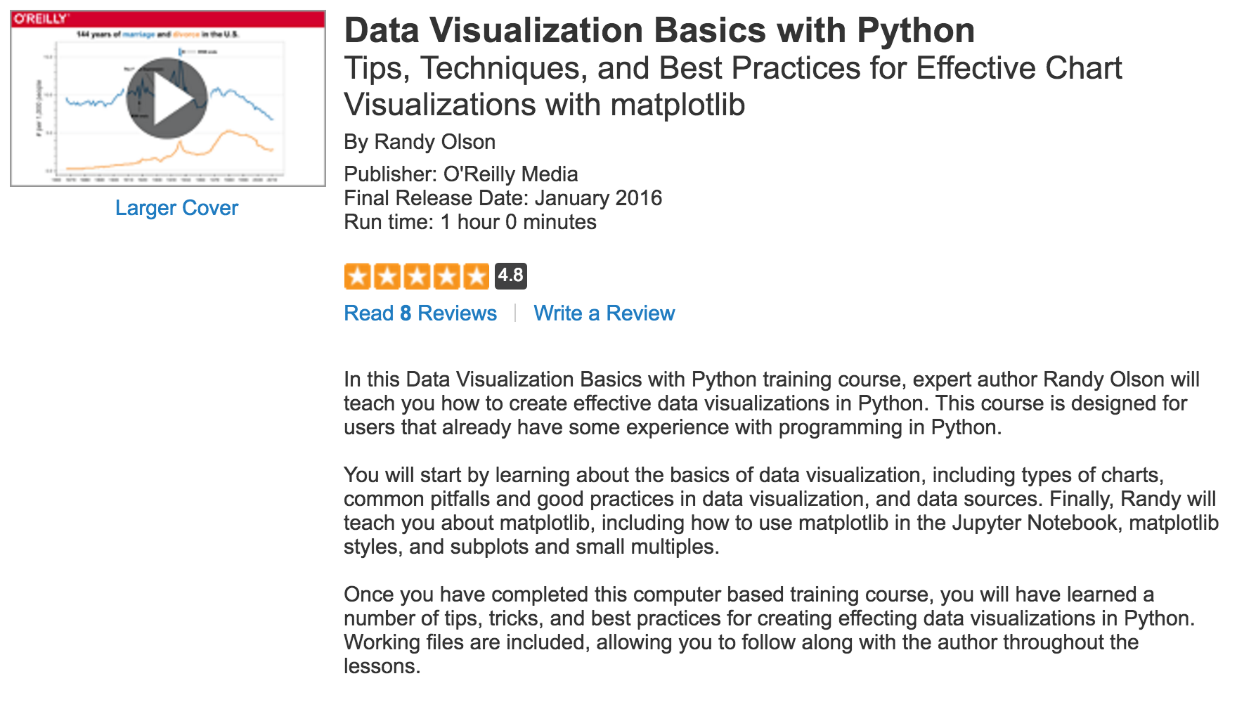
Acknowledgement
Portions of this lecture are modified from a talk by Randy Olson, PhD
Data blog: randalolson.com/blog/
Community leader: reddit.com/r/DataIsBeautiful
http://shop.oreilly.com/product/0636920046592.do

Slide 3



Types of Color Schemes
Choose color according to data type
Qualitative
Sequential
Diverging

Slide 4
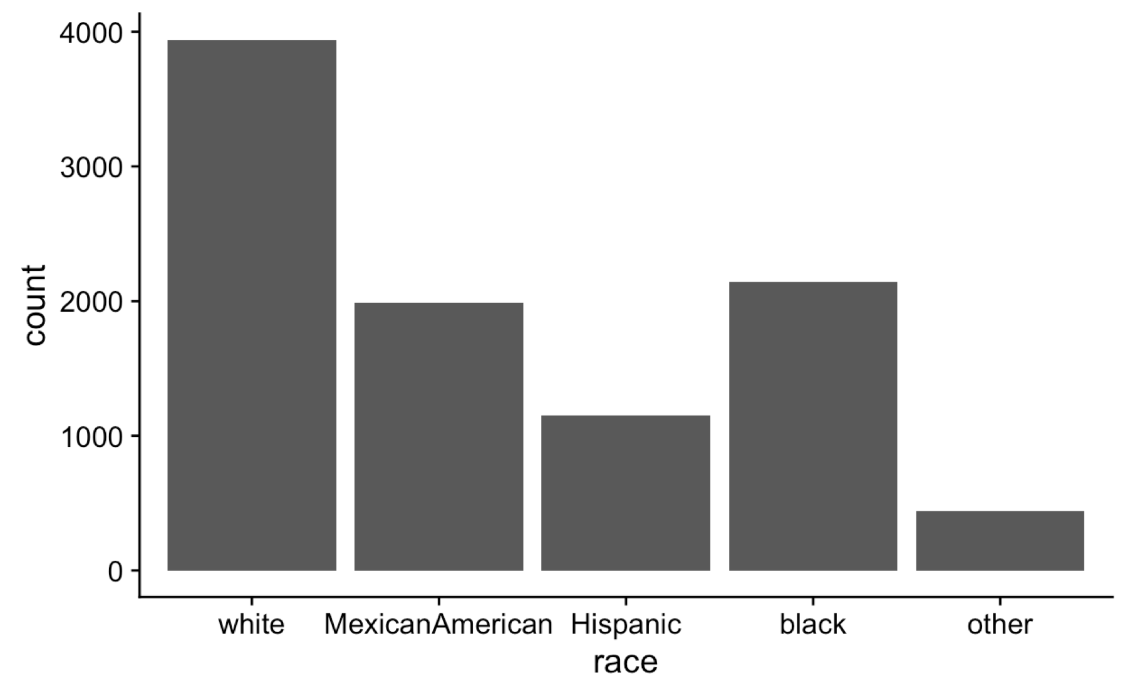
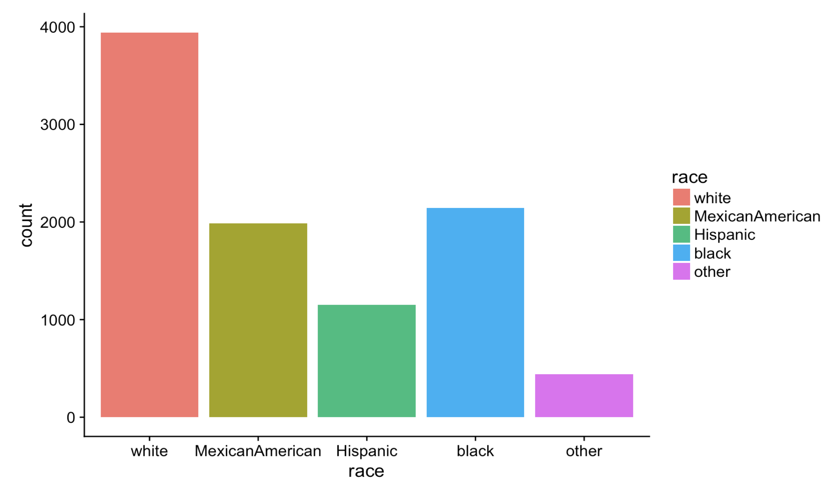
Color Should Add Information
Not distract
Not mislead

Slide 5
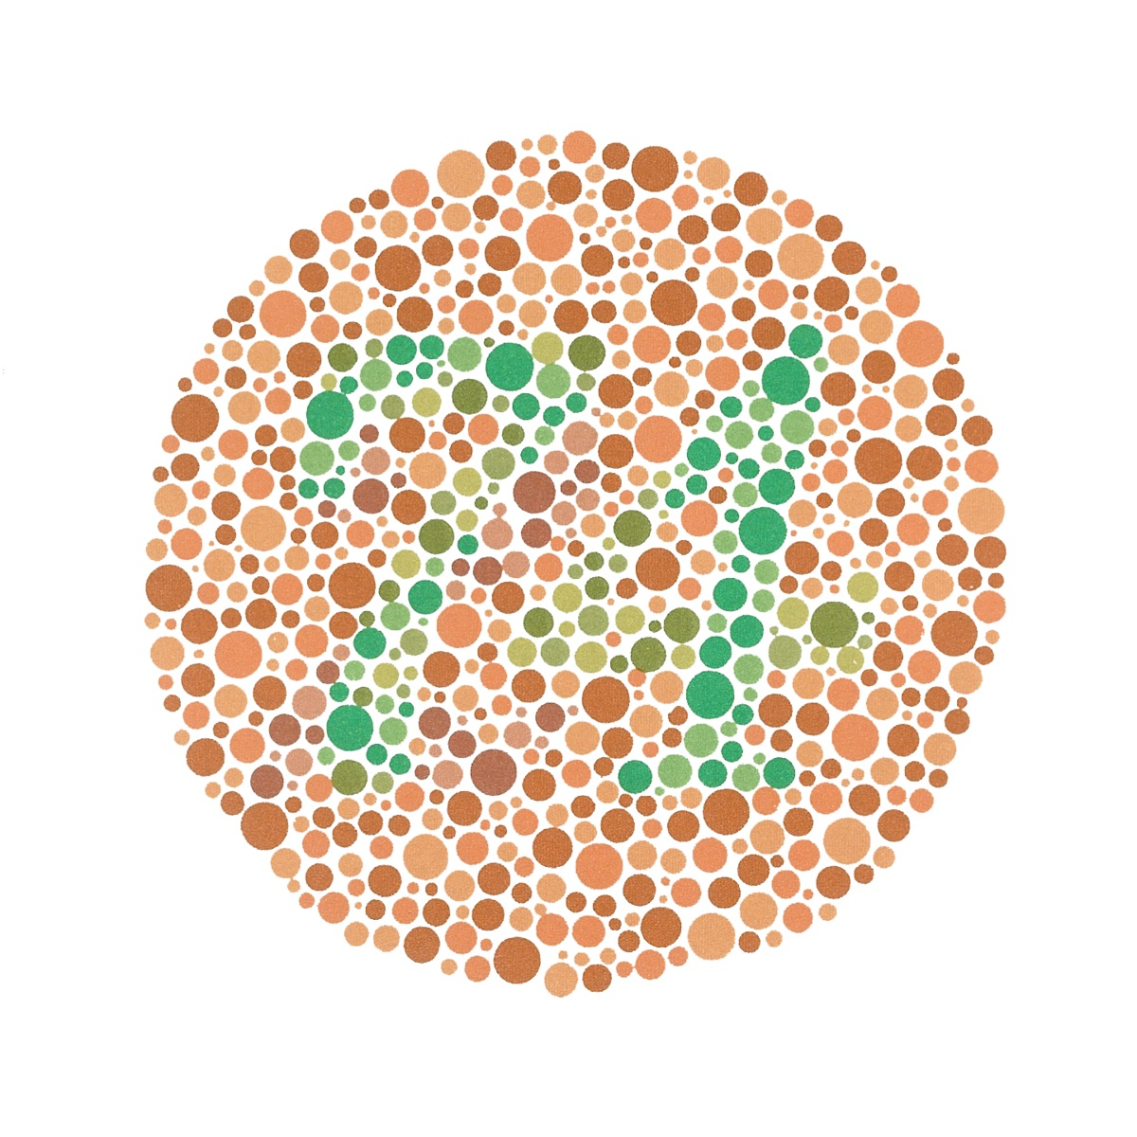
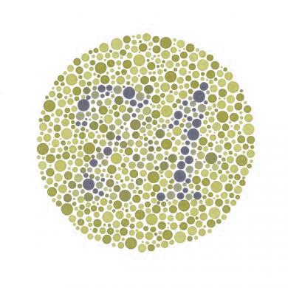


Consider Color Blindness
Color-blind friendly palettes:
http://www.cookbook-r.com/Graphs/Colors_(ggplot2)

Slide 6
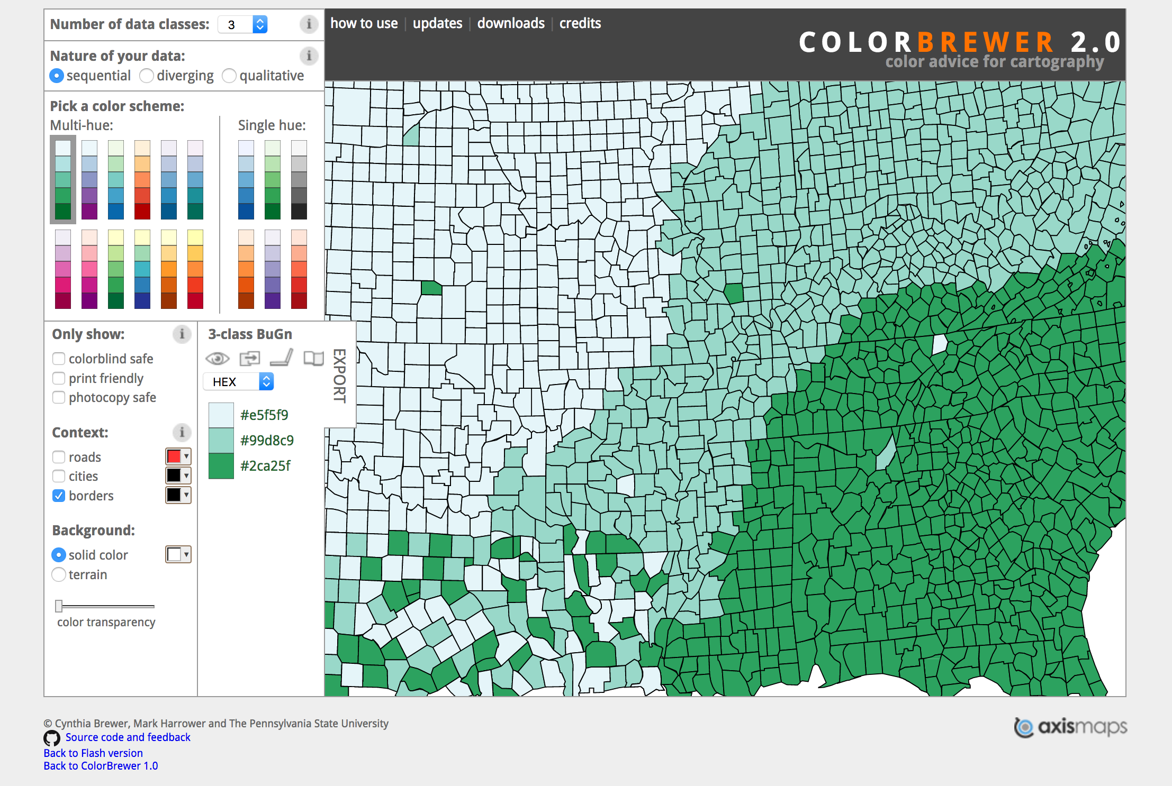
ColorBrewer
Provides excellent schemes, many designed for maps
http://colorbrewer2.org

Slide 7

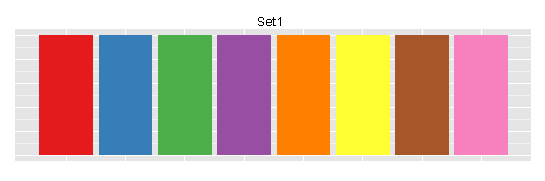
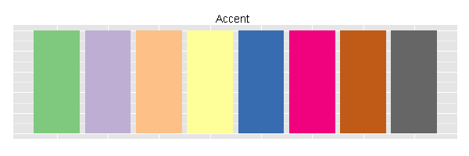
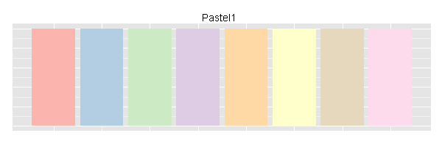
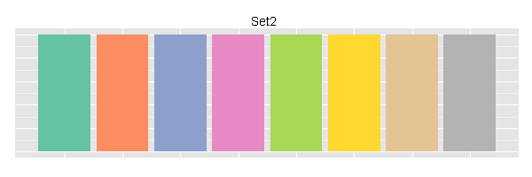
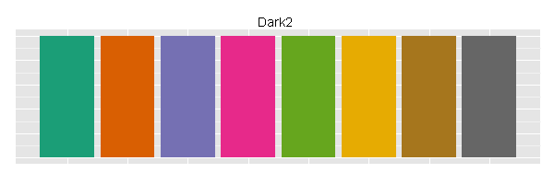
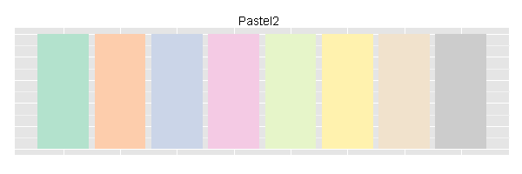
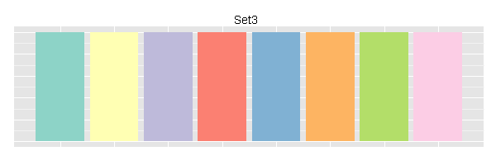
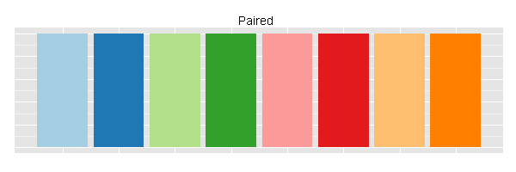
Colors in ggplot2
Default colors:
ColorBrewer palettes are available with scale_fill_brewer()
https://learnr.wordpress.com/2009/04/15/ggplot2-qualitative-colour-palettes

Slide 8
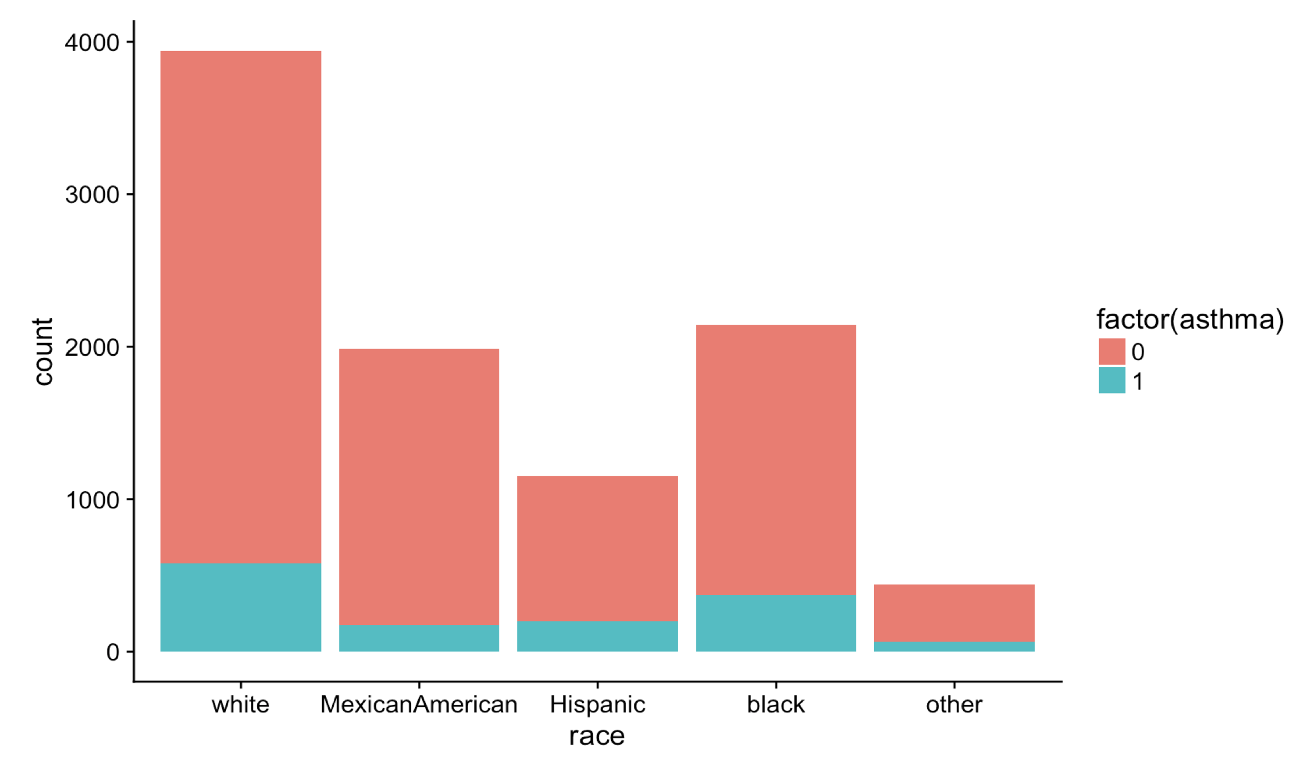
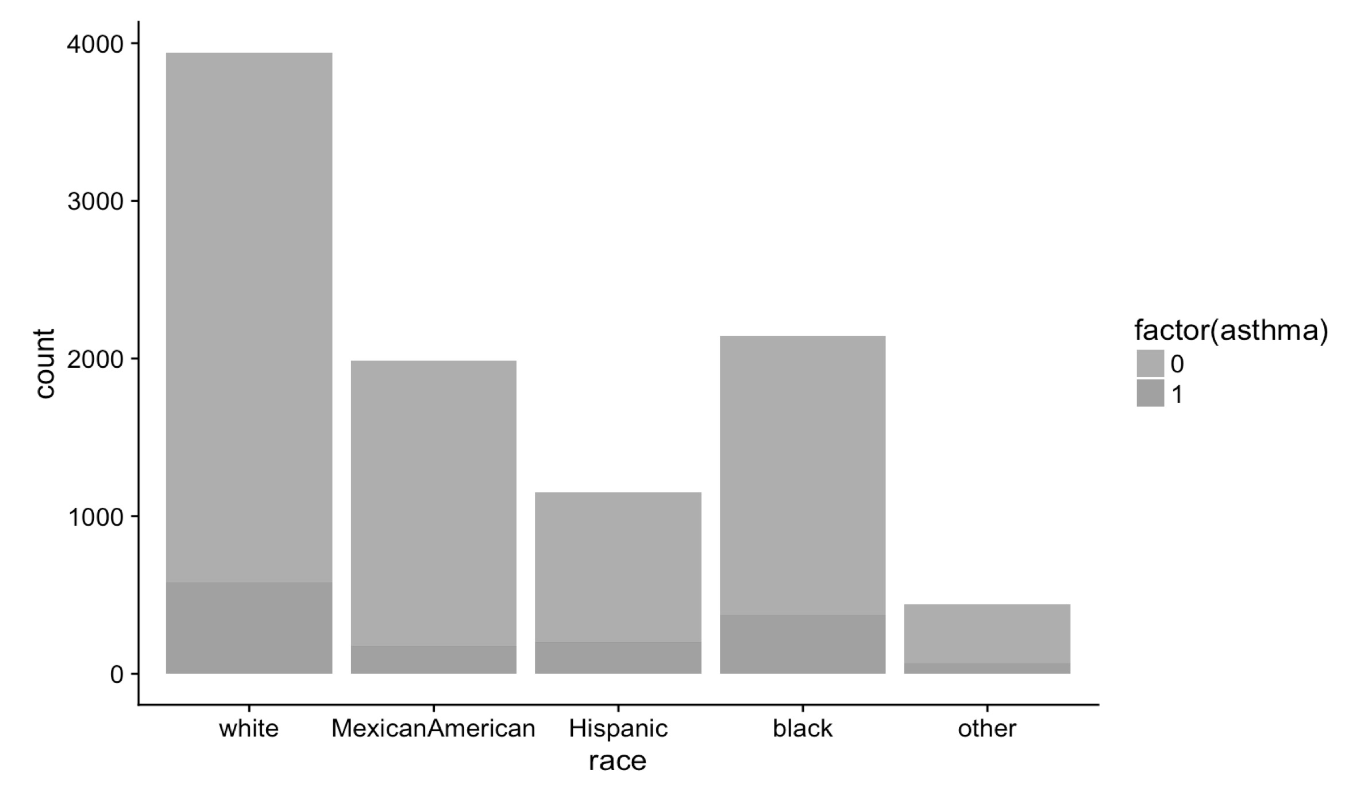
Check for Conversion to Black and White

Slide 9
Common Pitfalls: Unlabeled Charts

Slide 10
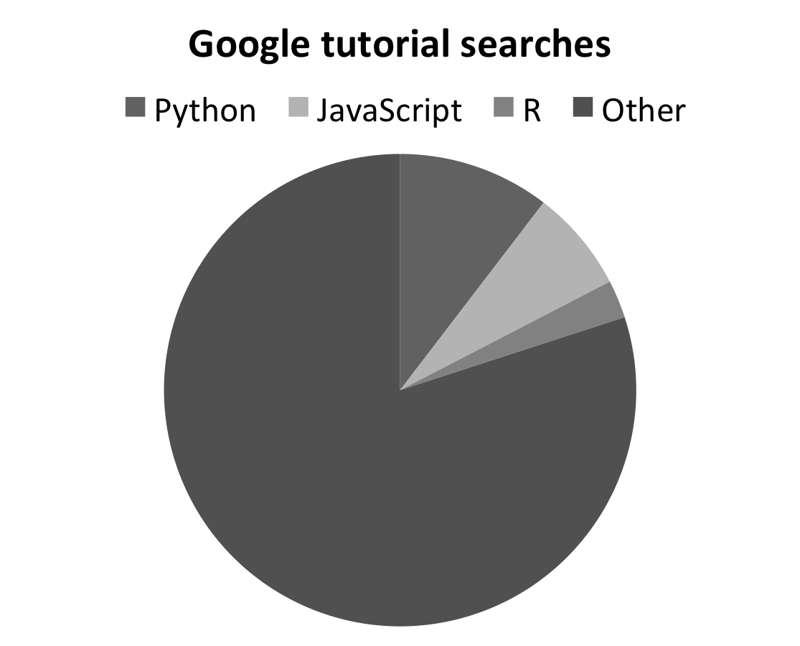
Common Pitfalls: Pie Charts

Slide 11
Common Pitfalls: 3D Charts

Slide 12
Common Pitfalls: Parts Don’t Sum to a Meaningful Whole

Slide 13
Common Pitfalls: Barcharts Not Starting at Zero
Note: Fake data

Slide 14
Common Pitfalls: Data Not Normalized
Note: Fake data

Slide 15
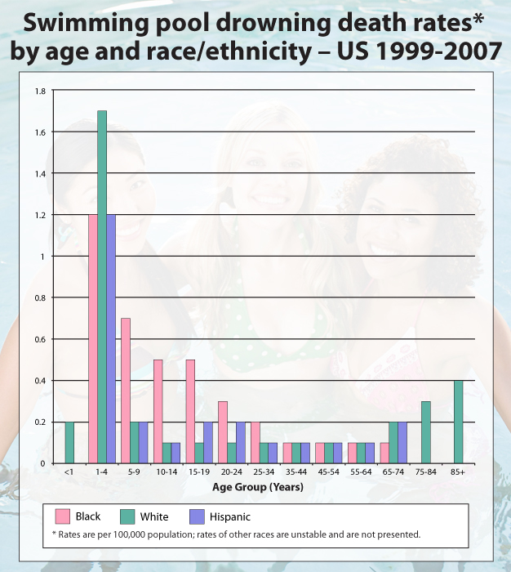
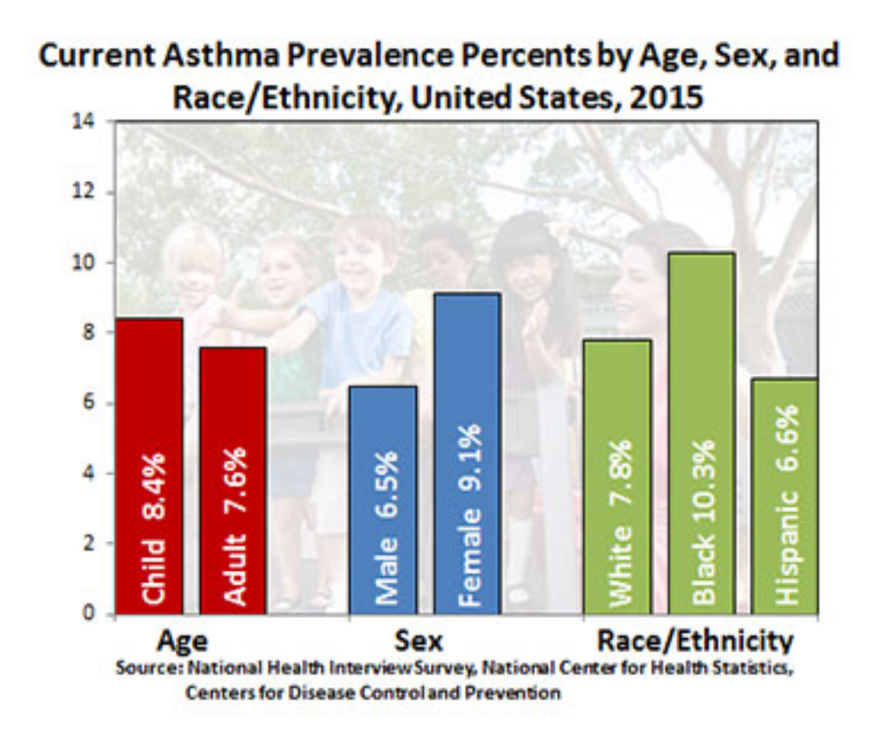
Common Pitfalls: Chart Junk
Extraneous labels
Pointless images
Excessive color
Fancy animations

Slide 16
Six-way Venn diagram showing the distribution of shared gene families (sequence clusters) among M. acuminata, P. dactylifera, Arabidopsis thaliana, Oryza sativa, Sorghum bicolor and Brachypodium distachyon genomes.
https://www.nature.com/articles/nature11241/figures/4

Slide 17
Good Practices: Show Data When Appropriate

Slide 18
Good Practices: Label Objects Directly

Slide 19
Good Practices: Label Data Directly

Slide 20
Final Project

Slide 21
Practicum 9
Go to course CANVAS page (https://canvas.upenn.edu)
Under “Files” download “9_visualization.html” and “9_visualization.Rmd”

